Slide 1

Year Up Corporate Partner
“The Safer, Easier Way to Pay.”
Ryan Nguyen

Slide 2

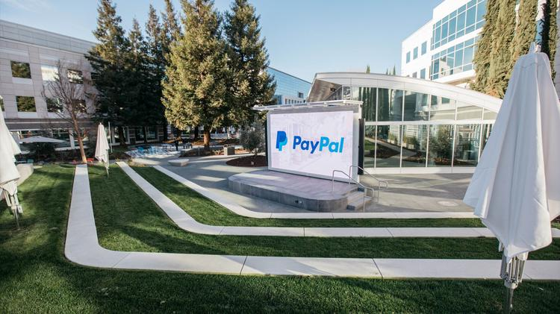
Company Overview
PayPal began in 1998 in Palo Alto, California.
The company currently has 18,000 employees across 47 office locations.

Slide 3
Company Overview
PayPal is an online service that allows users to purchase items using a secure online account.
Their customer base are those looking for a fast method of checkout via virtual wallet. They currently have 277 million active account holders.
Main competitors include companies such as WePay, Stripe, and 2checkout.com

Slide 4


In The News
In November, PayPal acquired Honey for $4 billion dollars. Honey is a web browser extension that helps online shoppers find the lowest prices.
Amazon is warning customers not to use the tool. Shortly before Christmas, Amazon said Honey posed a security risk.

Slide 5

Internship
Position
Data Analyst Intern
Responsible for facilitating Docker Containers
Automation
Setup of new pipelines
As an intern I can add value through determination to excel in my role. I will leverage my resources to learn new material to help perform my job. I will also be a great overall employee to the company.

Slide 6
Internship
Skills and Outcomes
Ability to naturally learn content quickly
Leadership
Python scripting
Linux OS
Docker Containers
I would like to ask for projects that would help me increase my skills in creating and managing Docker Containers. I will also utilize the web and self learning habits to teach myself.

Slide 7

Thank You

